Slide 1
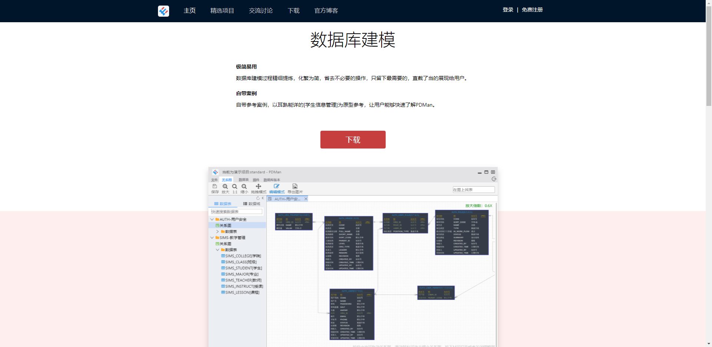
http://www.pdman.cn/#/

Slide 2
操作手册
https://www.yuque.com/chiner/docs/manual

